Slide 1
Contraception
Reproductive Health
Diploma In Clinical Medicine
Gulu College Of Health Sciences

Slide 2
Contraception
Definition: methods by which conception is prevented other than abstinence from coitus.
Disadvantages and risks of contraception:
Negative influence of some methods on coital practice.
Side effects and complications of the specific contraceptive method use.
Lowering fertility and postponed first pregnancy may encourage development of fibroids and endometriosis.
The ideal contraceptive: (such method doesn't exist), the ideal form should be: ­
Cheap and available
Easy to use
Absolutely free of side effects or complications
100% effective against pregnancy
Non-offending and unrelated to the act of coitus
Totally acceptable.
Completely reversible and does not delay the return of fertility
Does not need continuous motivation i.e. long acting

Slide 3
FAMILY PLANNING
Family planning allows individuals and couples to anticipate and attain their desired number of children and the spacing and timing of their births.
It is achieved through use of contraceptive methods and the treatment of involuntary infertility.
A woman’s ability to space and limit her pregnancies has a direct impact on her health and well-being as well as on the outcome of each pregnancy.

Slide 4
NON HORMONAL
ARTIFICIAL
a)Intra-uterine contraceptive device
b) Sterilisation; tubal ligation & Vasectomy
c)Barriers; condoms,diaphragms,cervical caps
Spermicides
NATURAL
a)Fertility awareness methods (NF
SP CAM,Behavioural: coitus interruptus
Lactational amenorrhea

Slide 5
HORMONAL MTDS
Oral contraceptives
Injectable contraceptives
Subdermal contraceptive implants
Hormone releasing IUD
Emergency contraception (EC((

Slide 6
Oral contraceptives (OCs)
Types of oral contraceptives (OCs(
a( Combined oral contraceptives (COCs):most widely used, contain both:
  - An estrogen: Ethinyl Estradiol (30 micrograms in second gen­eration pills(
  A progestagen (levonorgestrel is the most widely used prog­estagen 15 – 30 micrograms(
  Third generation pills contain gestodine, norgestimate, or desogestrel, and 20 micrograms ethinyl estradiol.
b( Progestin-only pills (POPS:(
  Contain only a progestagen, mostly levonorgestrel (no estrogen).
  Especially suitable for breastfeeding women
Mechanisms of action of oral contraceptives:
Suppression of ovulation by inhibition of the follicle-stimulat­ing hormone (FSH) and luteinizing hormone (LH) responsible for follicle development and ovulation (primary mechanism for COCs, and secondary for POPS(
Thickening of cervical mucus, making it difficult for sperms to enter the uterine cavity (primary mechanism for POPS, and sec­ondary for COCs).
Thining Endometrium,reduced tubal mortillity.

Slide 7
Advantages of oral contraceptives:
  Safe
  Highly effective: when used correctly and consistently, pregnancy prevention rate is more than 99%.
  Reversible ( rapid return to fertility).
  No action needed at the time of intercourse.
  Serious complications are extremely rare.
  Can have beneficial health effects other than contraception.
  Use is controlled by the woman.
Disadvantages of oral contraceptives:
  Incorrect use is common; not as effective in typical use
  Require daily pill intake
  Side effects are common
  May pose health risks for a small number of women
  Resupply required
  Offer no protection against sexually transmitted infections (STIs) including HIV

Slide 8
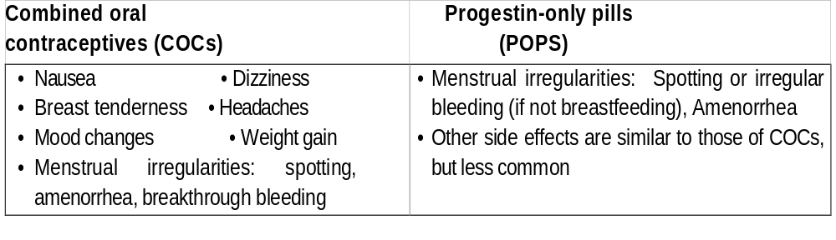
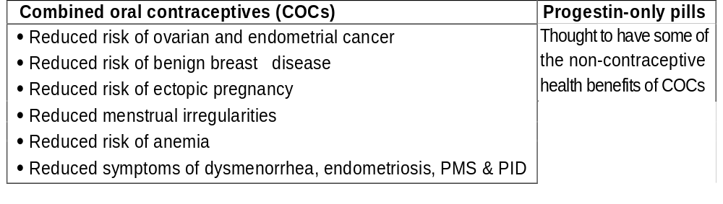
Side effects of oral contraceptives:-
Non-contraceptive health benefits of oral contraceptives:

Slide 9
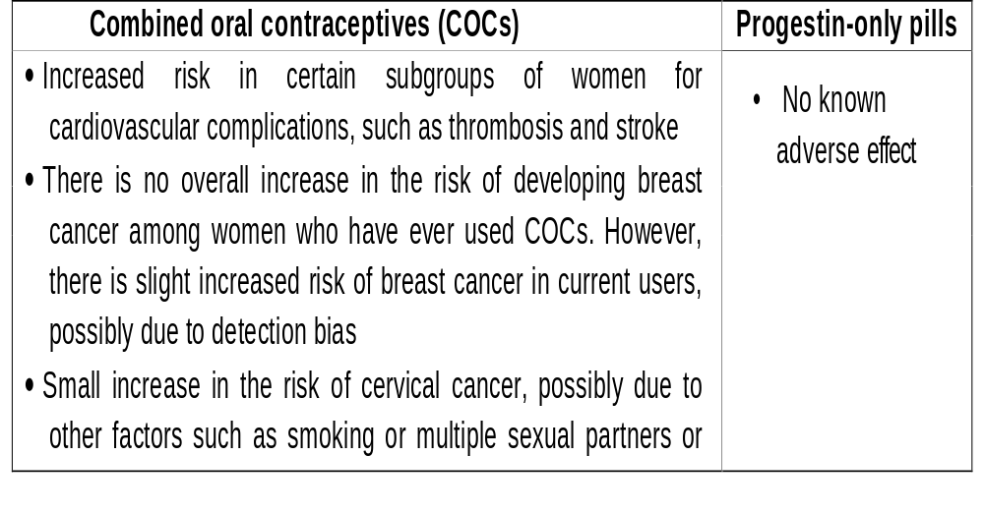
Adverse effects of oral contraceptives:

Slide 10
How to take COCs:
Initiating:
  During the first 5 days of the menstrual cycle, preferably on the FIRST day of menses
  Any time provider is reasonably sure woman is not pregnant.
  For non-breastfeeding women postpartum delay until 6 weeks after childbirth
  For breastfeeding women postpartum - delay until 6 months after childbirth or until breastfeeding is discontinued (estrogen component can reduce breast milk).
Schedule:
  Take 1 pill every day until all pills in the pack are finished (21 pills)
  Seven-days break between packs.
  Start another pack on day 7

Slide 11
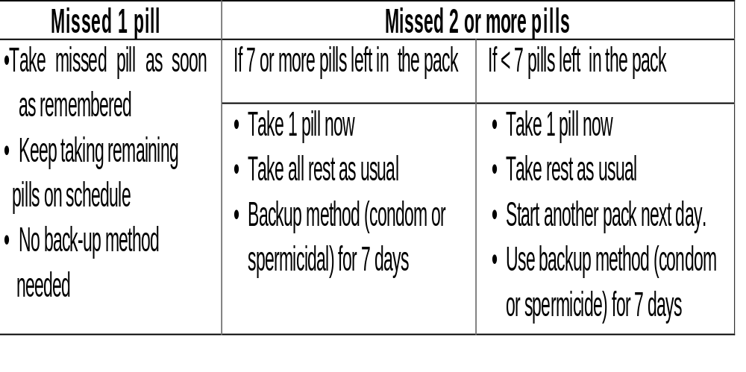
Missed pill regimen:

Slide 12
How to take POPS:
Initiating:
Postpartum breastfeeding women-delay 6 weeks
Postpartum non-breastfeeding women - can start immediately
Menstruating women:
  Preferably first 5 days of menstrual cycle
  Can start anytime provider is reasonably sure that woman is not pregnant
Schedule:
Take 1 pill each day
Take the pill within 3 hours of the same time each day (prefer­ably the same time)
No break between packs

Slide 13
Missed pill(s) regimen (if more than 3 hours late taking the pill(
- Take most recent missed pill as soon as possible
- If not breastfeeding, abstain from sexual intercourse or use back­ up method (condom or spermicide) for 48 hours
-Take next pill at regular time
POPS are more effective in breastfeeding women than in women who are not breastfeeding. Fully breastfeeding women who are amenor­rheic and are within the first 6 months after childbirth are still pro­tected from pregnancy if they miss pills. Women who are not fully breastfeeding, or not breastfeeding, those whose menses has returned, and those more than 6 months after childbirth, should have pregnan­cy ruled out.

Slide 14
WHO medical eligibility criteria for starting contraceptive methods:
The World Health Organization (WHO) classified potential contracep­tive users after screening them for a set of conditions. Each condition represents either an individual's characteristic (e.g. age, history of preg­nancy) or a known pre-existing medical/ pathological condition (e.g. diabetes, hypertension...etc(
The conditions affecting eligibility for the use of each contraceptive method were classified under one of the following 4 categories:

Slide 15
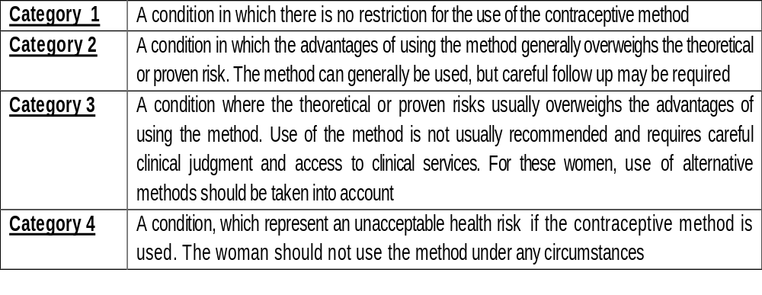
N.B. These categories has replaced the old classification into "indications", "relative contraindications", and " absolute' Contraindications"
WHO medical eligibility criteria (cont.)
Where a doctor is not available to make clinical judgment, WHO 4- category system can be simplified into a 2-category system as follows:
Category 1 and 2 → Use the method
Category 3 and 4 → Do not use the method

Slide 16
WHO medical eligibility criteria for starting combined oral contraceptives (COCs(
Women with the following conditions should not use COCs:
Pregnancy - Heavy smokers
Severe hypertension - Complicated diabetes
Current or past history of thromboembolic disorders
P. thrombovascular accidents
Current or past history of ischemic heart diseases
Prolonged immobilization
Valvular heart diseases with complication
Unexplained vaginal bleeding
Active liver disease, cirrhosis, liver tumors.
Migraine - Breast cancer
Epilepsy
Breastfeeding less than 6 weeks after childbirth

Slide 17
WHO medical E. criteria (cont.)
Women having following conditions may use COCs only after consideration of alternative methods and with careful medical evaluation and supervision
Age 35 and more, light smoker
Mild and moderate hypertension
Gallbladder disease
Current treatment with antibiotics (rifampin, griseofulvin) or antiepileptic drugs
Breastfeeding women 6 weeks to 6 months after childbirth
Not breastfeeding during first 3 weeks after childbirth.
WHO medical eligibility criteria for starting Progestin-only pills (POPs):
Women with the following conditions should not use POPs:
Pregnancy • Unexplained vaginal bleeding
Breast cancer • Gall bladder disease
Active viral hepatitis, liver cirrhosis, liver tumours
Receiving antibiotics (rifampin, griseofulvin) or anti-epileptic drugs
Breastfeeding and less than 6 weeks after childbirth

Slide 18
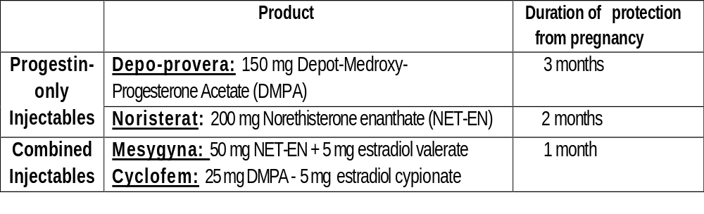
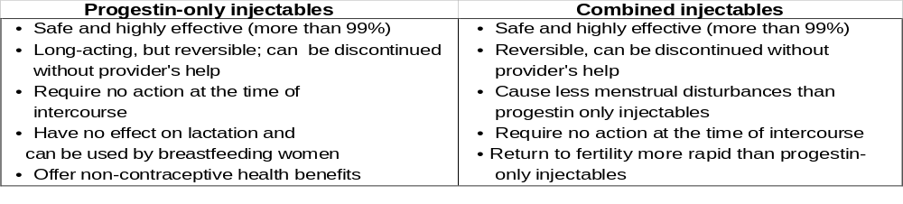
Injectable contraceptives
Types of injectable contraceptives:
Advantages of injectable contraceptives:

Slide 19
Mechanisms of action of injectable contraceptives:
Suppression of ovulation by inhibition of the follicle stimulating hormone (FSH) and Latinizing hormone (L.H) responsible for follicle development and ovulation.
Thickening of cervical mucus making it difficult for sperms to enter the uterine cavity.
Side effects of injectable contraceptives:
Menstrual changes: should be clearly explained to women before use (more common with progestin-only injectables than com­bined injectables)
Spotting, irregular bleeding
Prolonged or heavy bleeding
Amenorrhea
Weight gain
Less common side effects include headaches, dizziness, breast tenderness and mood changes

Slide 20
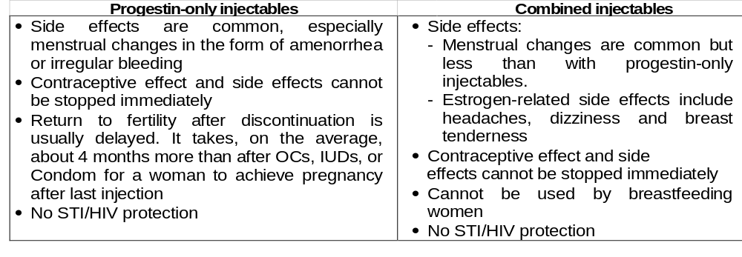
Non-contraceptive health benefits of progestin-only injectable contraceptives:
Reduced risk of: - Endometrial cancer and possibly ovarian cancer
  Ectopic pregnancy
  Vaginal yeast infection (moniliasis(
  Pelvic Inflammatory Disease (PlD(
  Fibroids
Reduced frequency and severity of sickle-cell disease crises
Reduced symptoms of endometriosis
Disadvantages of injectable contraceptives:

Slide 21
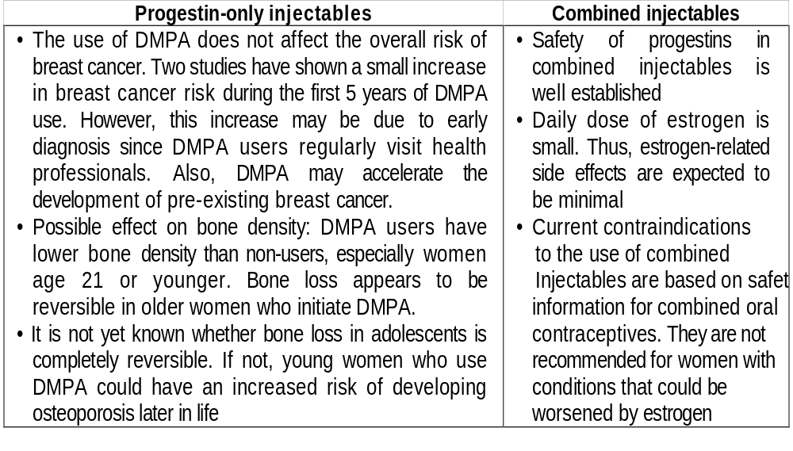
Long-term adverse effects and safety of injectable contraceptives:

Slide 22
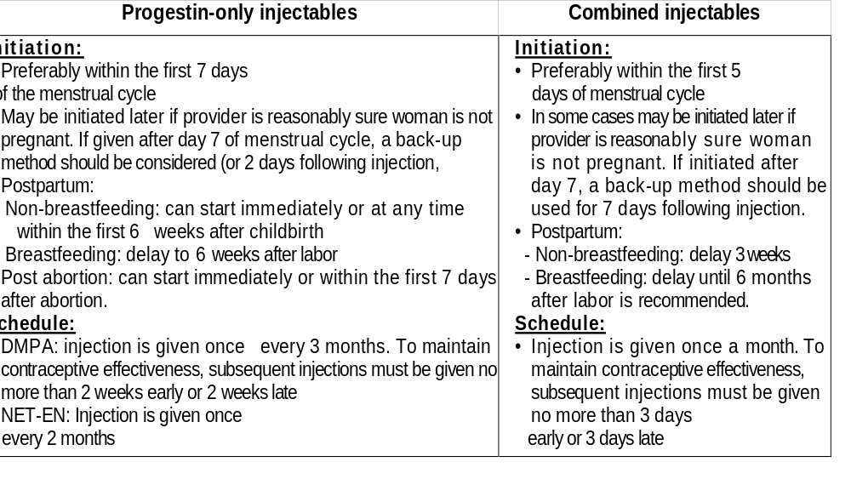
How to administer injectable contraceptives:

Slide 23
WHO Medical eligibility criteria for starting progestin - only injectable contraceptives:
Women with the following conditions should not use progestin-only injectable contraceptives:
Pregnancy
Unexplained vaginal bleeding
Breast cancer
Women having following conditions may use progestin - only injectables after consideration of alternative methods and with careful medical evaluation and supervision:
Severe hypertension
Complicated diabetes
Current or past history of ischaemic heart disease
Past cerebrovascular accident (stroke)
Active liver disease, cirrhosis, liver tumors
Breastfeeding mothers less than 6 weeks following childbirth
WHO medical eligibility criteria for starting combined injectable: are the same as COCs.

Slide 24
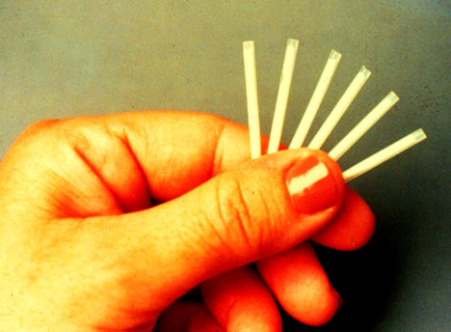
Subdermal contraceptive implants
Subdermal contraceptive implants are capsules placed by a special applicator through a small incision under the skin of the inner side of the upper arm and slowly release a progestin into the blood stream
Norplant:
The most widely studied and used subdermal implant is Norplant. With this method, 6 match-sized capsules are implanted and continu­ously deliver low doses of the progestin levonorgestrel to the blood­stream for 5 years. After 5 years, Norplant's effectiveness decreases and the capsules should be removed. If the woman wants to continue using Norplant, another set of capsules are inserted.
If the woman wants to discontinue Norplant at any time, the provider should respond to her request promptly after counseling by remov­ing the capsules and help her to choose another method of contraception if needed.

Slide 25
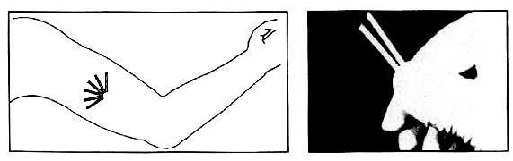
Mechanisms of action of Norplant:
Thickening of cervical mucus, making it difficult for sperms to enter the uterine cavity
Preventing ovulation in about half of a woman's menstrual cycles by inhibition of FSH and LH secretion.
Advantages of Norplant:
Norplant is safe and at least 99% effective in preventing preg­nancy
Easy to use. No action needs to be taken at the time of sexual intercourse, or any other time
It is long-acting, but reversible. The effectiveness of Norplant begins within a few hours after insertion and lasts for 5 years. However, Norplant can be reversed any time by removing the capsules, rapidly restoring fertility
It contains no estrogen, and can be used by women who are breastfeeding 6 weeks after labor.
Provides non contraceptive health benefits, such as decreased menstrual blood loss, prevention of ectopic pregnancy and pos­sibly decreased risk of endometrial cancer
Norplant

Slide 26
Disadvantages of Norplant:
Side effects are common, especially menstrual changes
It cannot be initiated or discontinued without a provider's help
A minor surgical procedure is required for both insertion and removal
Provides no protection against STIs, including HIV
Side effects of Norplant:
Bleeding irregularities are the most common and usually decreases after the first few months; possible effects include:
  - Spotting or irregular bleeding - - Prolonged bleeding
  - Amenorrhea (less common than with progestin-only injectables)
Less common: headache, breast tenderness, and weight gain.
Changes in the pattern of menstrual bleeding are the most com­mon reason that the women request Norplant removal during the first 2 years after insertion. Providers should comply prompt­ly with women's request to have implants removed and assist them in selecting another method

Slide 27
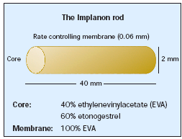
Implanon:
A progestagen-only subdermal implant
Consists of a single non-biodegradable rod measuring 40 mm in length and 2 mm in diameter that release 40 micrograms etonor­gestrel per day
As Norplant, it is inserted by a special applicator under the skin of the inner side of the upper arm through a small incision and provides highly reliable protec­tion, nearly 100%, for up to 3 years.
Insertion and removal is easier than Norplant.
Mode of action: (1) mainly by inhibition of ovulation (2) thicken­ing of the cervical mucus.
Side effects include amenorrhea, irregular bleeding pattern, weight gain, acne, headaches, and breast tenderness.
The Implant should be removed 3 years after insertion or at any time the woman request removal
Fertility is restored after removal
As Norplant, the method is free of estrogen and is suitable for breastfeeding mothers in whom it should be inserted 6 weeks after labor.

Slide 28
Intrauterine contraceptive devices (IUCDs(
Most intrauterine devices (IUDs) being inserted today are shaped like a T with copper wires or bands on the plastic stem and arms. The TCu 380A (shown in the picture below) is currently one of the most widely used copper IUDs worldwide. The device is inserted in the uterus by a special inserter; the nylon filaments protrude through the cervix and can be felt in the upper vagina.
Mechanism of action of the Copper lUD:
Prevents fertilization by causing local foreign body reaction hostile to sperms and possibly to the ovum.

Slide 29
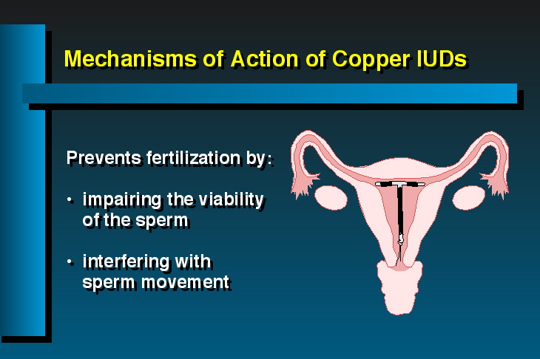
Advantages of Copper IUD:
Very safe and highly effec­tive (more than 99%). Pregnancy in the pres­ence of an IUD rarely occurs.
Easy to use, requiring no action at the time of intercourse or at any other time and can be removed easily by a service provider gently pulling on the nylon threads
Long acting (10 years) but easily reversible, with return to fertility typically occurring; very soon after removal
No systemic side effects
Can be used safely by breastfeeding women
Complications, such as perforation or expulsion, are rare
Can be used safely by breastfeeding women

Slide 30
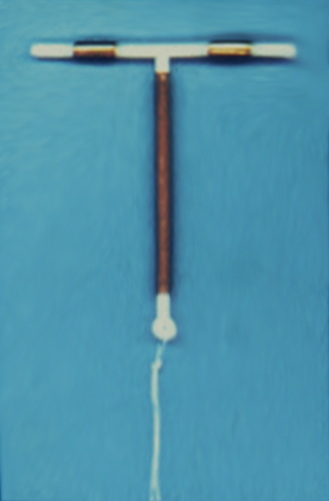
Side effects of IUDs:
Menorrhagia and/or bleeding between menstrual periods
Dysmenorrhea and/or lower abdominal colic.
Inability to feel the nylon threads.
Side effects are more common during the first months after insertion of a copper IUD, and usually decrease with time.
Disadvantages of the IUD:
Can cause side effects
A trained health care provider is needed to insert and remove the device Is not recommended for women at risk of STIs
Offer no protection against STIs, including HIV
TCu 380A

Slide 31
Complications of IUDs:
• Pelvic Inflammatory Disease (PID(
  - IUD use has been associated with a small increased risk of developing PID during the first month after insertion
  - Risk is presumed to be due to the introduction into the uterus of bacteria from the lower genital tract as the IUD is being inserted
  - Risk can he substantially reduced if providers screen poten­tial users for symptoms and signs of current STI, and assess for their STI risk. Also, infection prevention techniques dur­ing insertion should be strictly followed to avoid introducing pathogens into the uterus
• Perforation:
  - Rare, but a potentially serious event
  - Risk is directly linked to the skill and experience of the provider, and can he reduced through supervised training.
  - Risk is greater for postpartum insertions performed between 48 hours and 4 weeks after delivery. For this reason, it is rec­ommended that postpartum insertions be done within the first 48 hours after delivery or no sooner than 4 weeks after delivery.

Slide 32
Complications of IUDs (cont.)
• Ectopic pregnancy: Overall, TCu 380A protects from ectopic pregnancy. Incidence among users of TCu 380A is very low. When pregnancy occurs among IUDs users, one in each thirty is ectopic preg­nancy, which is slightly higher than in women using some other contraceptive methods.
• Expulsion:
  - Partial or unnoticed expulsion may result in irregular bleed­ing, pain and/or pregnancy
  - Factors affecting expulsion rates include provider's insertion skills, a woman's (young) age and nulliparity (having no chil­dren), length of time since insertion, and timing of insertion

Slide 33
Timing of IUD insertion:
• Interval insertion:
  - During menstruation
  - Can be inserted any time during the menstrual cycle if provider is reasonably sure that the woman is not pregnant and cannot protect herself from pregnancy until next men­struation, or cannot visit the clinic during menstruation
• Postpartum insertion:
  - Immediately after vaginal delivery by a specially trained provider if no infection or hemorrhage (within 10 minutes after delivery of placenta), or during cesarean section
  - within the first 48 hours, or after 4 weeks
• Insertions after abortion:
  - Immediately if no infection
  - If the pregnancy was 16 weeks or more, IUD insertion should be performed immediately by a specially trained provider, or be delayed 4 to 6 weeks

Slide 34
WHO medical eligibility criteria for starting IUDs use:
Women with the following conditions should not use IUDs:
Pregnancy
Unexplained vaginal bleeding
Cervical, endometrial, or ovarian cancer
Current or recent Pelvic Inflammatory Disease (PID), STIs, septic abortion, or pelvic TB
Distorted uterine cavity
Women having following conditions may use IUDs only after considera­tion of alternative methods and with careful medical evaluation and supervision:
Risk of developing STIs
HIV /AIDS infection

Slide 35
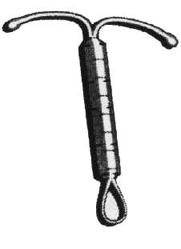
Hormone-releasing intrauterine system (IUS(
The hormone-releasing intrauterine system (IUS) is a newer form of hormonal contraception. Like the most widely used IUDs, it has a T shape and is inserted into the uterus. Unlike an IUD, however, the IUS contains progestin that is released directly into the uterus. The IUS is not a substitute for the copper-bearing IUD. However, it can be used if a woman develops excessive bleeding with cop­per IUD, which she can't tolerate, still want to use an intra-uterine device, and can afford a high price of the hormone-releas­ing IUS. In this case she should be counseled that she will be using a hormonal rather than a non-hormonal method, and the provider must rule out any condition that contraindicate prog­estin and IUD use prior to initiation
I US

Slide 36
Mechanisms of action of hormone- releasing IUS:
Thickening of the cervical mucus prevents sperms from entering the uterine cavity
Partial suppression of ovulation
Advantages of IUS:
Safe and highly effective
Easy to use; no action required at the time of sexual intercourse, or any other time
long-acting (5 years), but reversible
Has non-contraceptive health benefits, such as reducing the dura­tion and quantity of menstrual bleeding and pain, possibly pro­vides protection from pelvic inflammatory disease (PID)
Disadvantages of IUS:
Provider's help needed in order to initiate or discontinue
Side effects, such as irregular bleeding and spotting, are common
Provides no protection from STIs, including HIV
Expensive

Slide 37
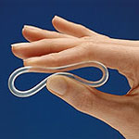
Contraceptive vaginal rings
The contraceptive vaginal ring is a flexible, soft, transparent ring with an outer diameter of 54 mm and a cross section of 4 mm.
It releases 120 microgram of the progestagen etonogestrel and 15 microgram of ethinyl estradiol per day that are absorbed from the vaginal mucous membrane
The ring can be easily inserted in the vagina and removed by the women herself
After insertion, the ring is left in the vagina for three weeks and then removed.
The woman remains ring-free for one week after which a new ring is inserted
The method prevents pregnan­cy mainly by inhibition of ovu­lation that is achieved by a lower dose of ethinyl estradiol than the oral pills
It is highly effective, well toler­ated, and induces good cycle control. Most common causes for dis­continuation are a foreign body sensation, coital problems and expulsion of the device
vaginal ring

Slide 38
Barrier methods
Barrier methods of contraception include the male condom, female condom, diaphragm, and spermicides. All barrier methods are client-dependent. To be effective, they need to be used correctly and consistently with every act of sexual intercourse. Correct and consistent use requires motivation, skills and, often, communication between partners.
Mechanism of action:
These methods work by physically or chemically blocking the passage of sperm. In some cases, they can also prevent transmission of STIs between partners.
Advantages of barrier methods:
Effective in preventing pregnancy if used consistently and cor­rectly. However, some are more effective than others
Condoms can be effective in preventing STIs, including HIV, if used consistently and correctly
Safe
Have no systemic side effects
Easy to initiate and discontinue
Immediate return to fertility after stopping method.
Except for the diaphragm, barrier methods do not require a clin­ic visit

Slide 39
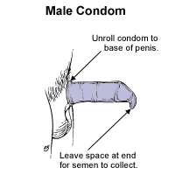
Disadvantages of barrier methods:
Not as effective as other modern methods
Some people find them difficult to use consistently and correctly
Some methods require partner's participation
Coitus related and may interrupt sexual activity
Need proper storage in order to maintain the quality of the products
Need re-supply.

Slide 40
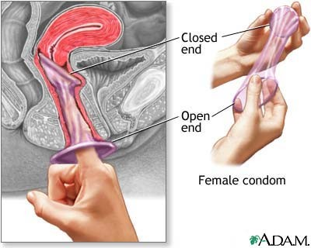
Characteristics of barrier methods:
Male latex condom:
Effective in preventing pregnancy if used consistently and correctly (fail­ure rate 3%( Less effective as commonly used (failure rate 14%(
Widely available.
Proven protection against STIs, including HIV
Requires male partner cooperation
Can be damaged by exposure to oil-based lubri­cants, heat, humidity or light
Female condom: ( available in Uganda}
Internal ring inserted deeply in the vagina, external wide ring protects vulval and perineal skin
Effective when used consistently and correctly
less effective as commonly used
Protects from bacterial and possibly viral STIs

Slide 41
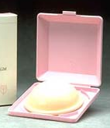
Diaphragm:
The Diaphragm fits obliquely in the vagina
More effective when used with spermicides
First time must be fitted by a trained provider
Reusable (after cleaning)
Can be inserted up to 6 hours before intercourse
Should not be removed earlier than 6 hours after intercourse; no douching after intercourse or before removal
It may cause irritation and urinary tract infection
May decrease the risk of some bacterial STIs when used with spermicides

Slide 42
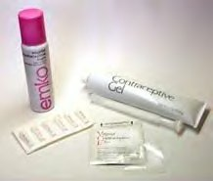
Spermicides
Active ingredient mostly Nonoxynol-9 in foaming tablets, foam or cream
Much less effective than other modern methods
Work by inactivating sperm
Provide modest protection against bacterial STIs
Can increase urinary tract infection in women
Dual method use:
Condoms are used as a primary method for protection against STI and pregnancy. Emergency contraception can be used as a back-up method if a condom breaks or slips, or not used for particular act of intercourse. Emergency contraception, however, will not protect against STI transmission.
An alternative approach is to use a highly effective method as a primary means for pregnancy prevention, and still use a male or female condom for STI prevention

Slide 43
Lactational amenorrhea method (LAM(
The lactational amenorrhea method (LAM) is a temporary contracep­tive option for postpartum women.
To use LAM, a woman must be:
Within 6 months postpartum
Amenorrheic
Fully or nearly fully breastfeeding (at least 85% of baby feeding is breast milk(
For women who meet these criteria, LAM is more than 98% effective. For continued protection against pregnancy, another method of contra­ception should be introduced when any of the LAM criteria expires, particularly when menses return.
Mechanism of action:
The stimulation of the nipples by infant's suckling sends nerve impulses to mother's hypothalamus causing the release of pro­lactin and disruption in the release of gonadotrophin releasing hormone (GnRH).
The reduction in Gn RH in turn suppresses the release of follicle stimulating hormone (FSH) and luteinizing hormone (LH) by pituitary gland and suppresses ovulation.

Slide 44
Advantages of LAM:
Universally available to all breastfeeding women
At least 98% effective
Protection begins immediately postpartum
There are proven health benefits of breastfeeding for mother and infant
No commodities or supplies required
LAM can be used temporarily while a breastfeeding woman decides about other method to use.
Disadvantages of LAM:
Full or nearly full breastfeeding may be difficult to maintain for some women due to social circumstances
No STI or HIV protection
Duration of method is limited
LAM is a temporary method that can only be used by breast­feeding women

Slide 45
Other contraceptive options for breastfeeding women:
Use of contraceptive methods postpartum is based on what impact, if any a method may have on lactation, breast milk, and infant health.
Methods that can be started by breastfeeding women immediately postpartum:
IUDs
Barrier methods
Female sterilization (if there is a medical indication)
Methods that can be started by breastfeeding women 6 weeks post­partum: (Progestagen-only methods(
Progestin-only pills (POPS)
Progcstin-only Injectables (DMPA, NET-EN)
Subdermal implants (Norplant or Implanon)
Hormonal IUS
Methods that can be started by breastfeeding women 6 months postpartum: methods containing estrogen:
Combined oral contraceptives (COCs)
Combined monthly injectables
  Non hormonal methods should be the first choice for
  breast feeding women followed by progestagen only methods.

Slide 46
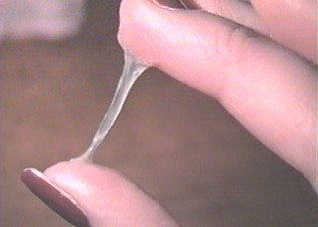
Other non - hormonal methods
Periodic abstinence:
Periodic abstinence involves abstaining from intercourse during a woman's fertile time. A woman uses various signs to identify when she is fertile and during this time abstains from sexual intercourse.
Several techniques exist to identify the fertile phase of the menstrual cycle:
The calendar or rhythm Method, whereby a woman uses past menstrual cycles to calculate when she will be fertile
The basal body temperature method: whereby a woman identi­fies when she is fertile by noting the rise in basal body tempera­ture that occurs just after ovulation
The cervical mucus method, whereby a woman identifies when she is fertile by noting changes in the appearance and texture of the cervical mucus The symptothermal method: in which several techniques are combined to predict when a woman is fertile. This method typ­ically includes monitoring cervical mucus and temperature changes, and may include other signs of ovulation, such as breast tenderness, back pain or abdominal discomfort
cervical mucus method

Slide 47
Withdrawal: also known as coitus interrupts
It requires removing the penis from the vagina before ejaculation so as to prevent contact between sperm and ovum.
Disadvantages of withdrawal:
Contraceptive efficacy is similar to that of barrier methods, with failure rates of about 4% for perfect use and at least 19% for typical use during the first year
Correct and consistent use requires self-control
Provides no protection from STIs/HIV

Slide 48
Emergency contraception
Emergency contraception (EC) is the use of certain methods after unprotected intercourse to prevent pregnancy. Unprotected inter­course includes the following situations:
  No method used, including coercive sex and rape
  Method did not function properly; such as condom tear.
  Method used incorrectly, such as missed pills or failure to with­draw.
Options for emergency contraception:
Special regimens of hormonal contraceptive pills initiated as soon as possible after unprotected intercourse, but not later than 72 hours.
  - Progestin-only pills (POPS) are more effective and have fewer side-effects than combined pills.
  - Combined oral contraceptives (COCs)
Copper IUDs inserted within 5 days after unprotected inter­course
Possible mechanisms of action:
Depending on the time of administration during the menstrual cycle, the pills may:
  - Inhibit or delay ovulation
  - Have other contraceptive effects after ovulation.
But they do not interfere with an already established pregnancy

Slide 49
Emergency contraceptive pills (ECPs(
Progestin-only pills regimen:
  First dose (0.75 mg of levonorgestrel) should be taken as soon as possible, and not later than 72 hours after unprotected inter­course
  Repeat same dose: 12 hours after first dose
  Pills containing 0.75 mg of levonorgestrel = 1pill per dose.
  Pills containing0.0375mg of levonorgestrel = 20 pills per dose.
  Pills containing 0.03 mg of levonorgestrel - 25 pills per dose.
Combined oral contraceptive pills regimen (known as Yuzpe regimen(
Each dose should contain at least 0.1 mg of ethinyl estradiol and (0.5 mg of levonorgestrel, which equals four tablets of the standard low-dose COCs.
  - First dose must be taken as soon as possible and not later than 72 hours after unprotected intercourse
  - Repeat same dose 12 hours after first dose

Slide 50
Copper IUD for emergency contraception:
Inserted within 5 days after unprotected intercourse
Highly effective (0.1% pregnancy rate)
Side effects include cramping, heavy menstrual bleeding and spotting
After insertion, can be left to provide ongoing contraception

Slide 51
A. Female sterilization (tubal occlusion(
Voluntary female sterilization is widely used worldwide. It involves surgically closing and cutting or clipping the fallopian tubes to prevent the ovum from being fertilized.
In female sterilization is pro­vided in cases when pregnan­cy presents a risk to woman's health; in other words, when medical indications exist to warrant the procedure,women who need parnement method
Advantages of female sterilization:
Very safe & highly effective (99.5% in 1st year of use, 98.1% overall for 10 years of use.
Permanent method
Virtually no long-term adverse effects
Disadvantages of female sterilization:
Exposes clients to a small risk of surgical complications such as injury to other organs, infection or bleeding
Offers no protection against STIs, including HIV
Cannot be reversed should the woman change her mind
Can have a relatively high initial cost

Slide 52
Timing of female sterilization:
Immediately or within the first 7 days after a vaginal delivery (post­partum).
During a cesarean section.
At any other time between pregnancies except between the 7th day following delivery and 4 to 6 weeks after delivery.
Long-term health effects of female sterilization:
Research shows that sterilization does not cause women to expe­rience menstrual irregularities, including painful menses, heavy bleeding, and changes in cycle length. These symptoms, some­times termed post-sterilization syndrome or post-tubal-ligation syndrome, appear to be related to other gynecologic disorders or previous use of contraceptive methods such as OCs
  No effect on normal sexual function
  Protects against ovarian cancer
  Protects from Pelvic Inflammatory Disease (PID)

Slide 53
B. Male Sterilization (vasectomy(:
Voluntary male sterilization, or vasectomy, is a minor surgery in which the vas deferens (tubes that carry the sperms from the testes to the urethra) are tied and cut to prevent sperms from mixing with the seminal fluid. Ejaculated semen that does not contain sperms cannot fertilize an ovum.
Vasectomy is technically simpler to provide than female steriliza­tion, however the method is not commonly offered . Vasectomy is:
  A permanent method of contraception
  Safe and has no long-term side effects
  Not immediately effective. A waiting period of 12 weeks or 20 ejaculations is recommended before couple can rely on vasecto­my to prevent pregnancy
  Surgery to reverse both male and female sterilization requires a well equipped center with microsurgical techniques and a well-trained, highly qualified specialists. Still, the success rates are low.

